Slide 1


[Title]

Slide 2


Today's agenda
Project recap
Problem
The Analytics team
Process
Insights
Summary

Slide 3
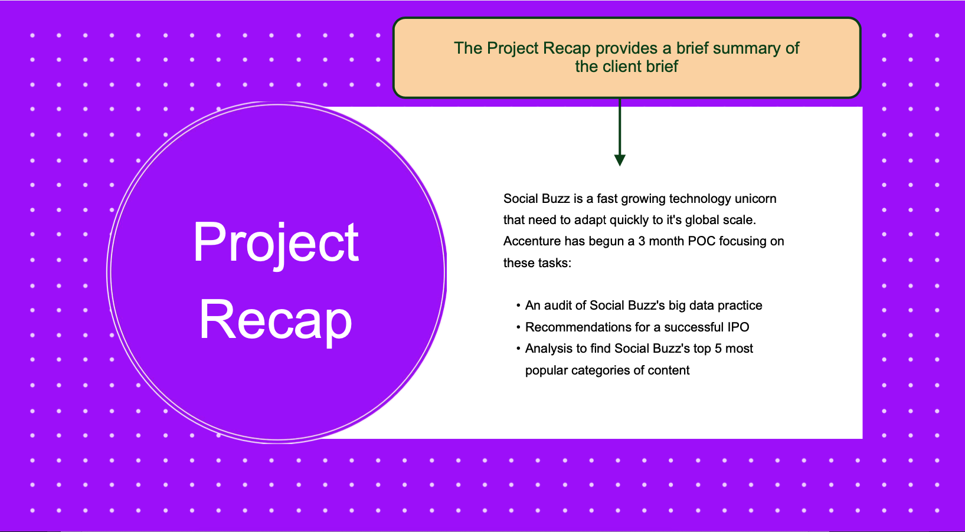

Slide 4
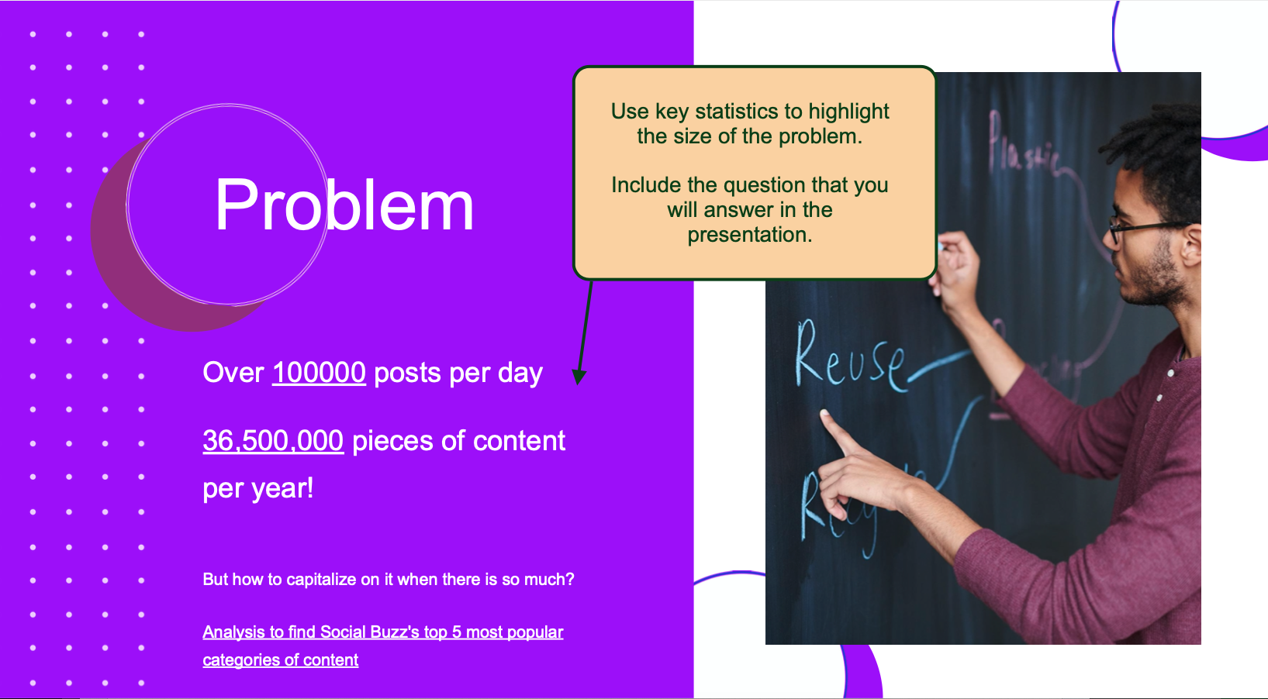

Slide 5
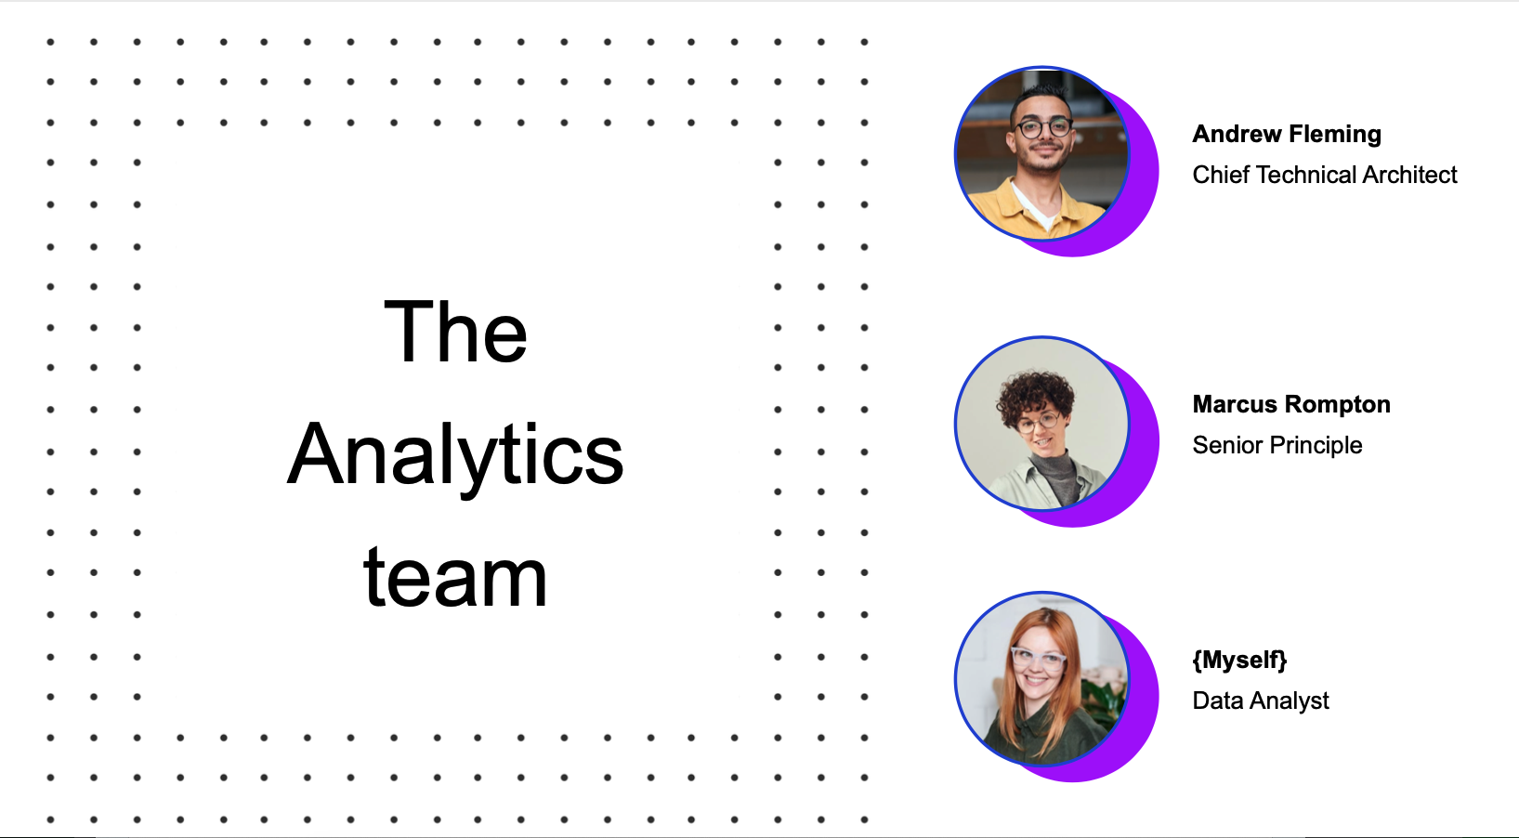

Slide 6
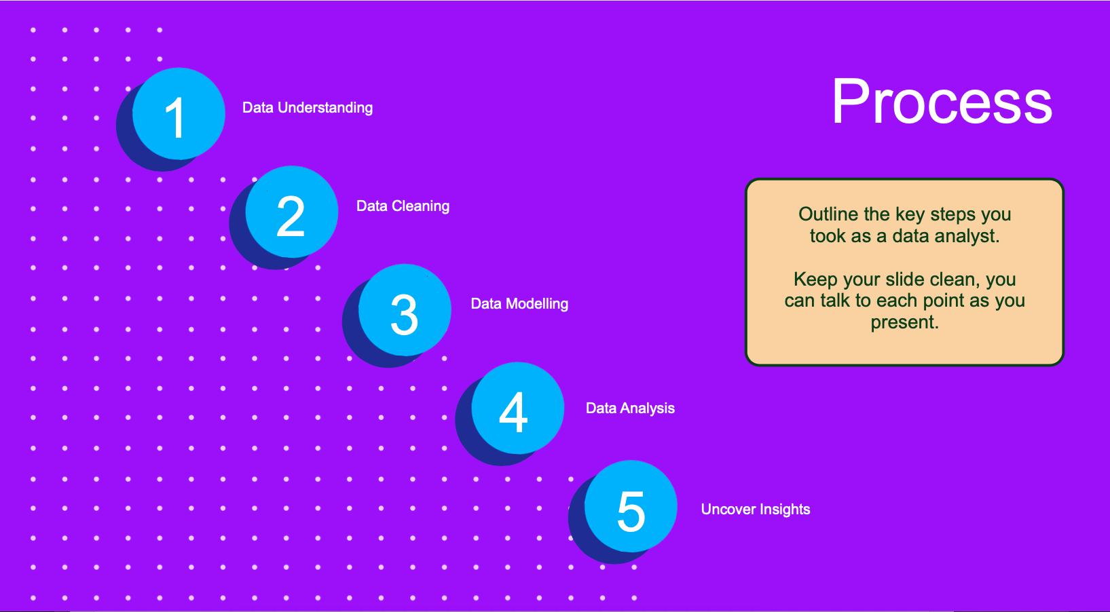

Slide 7
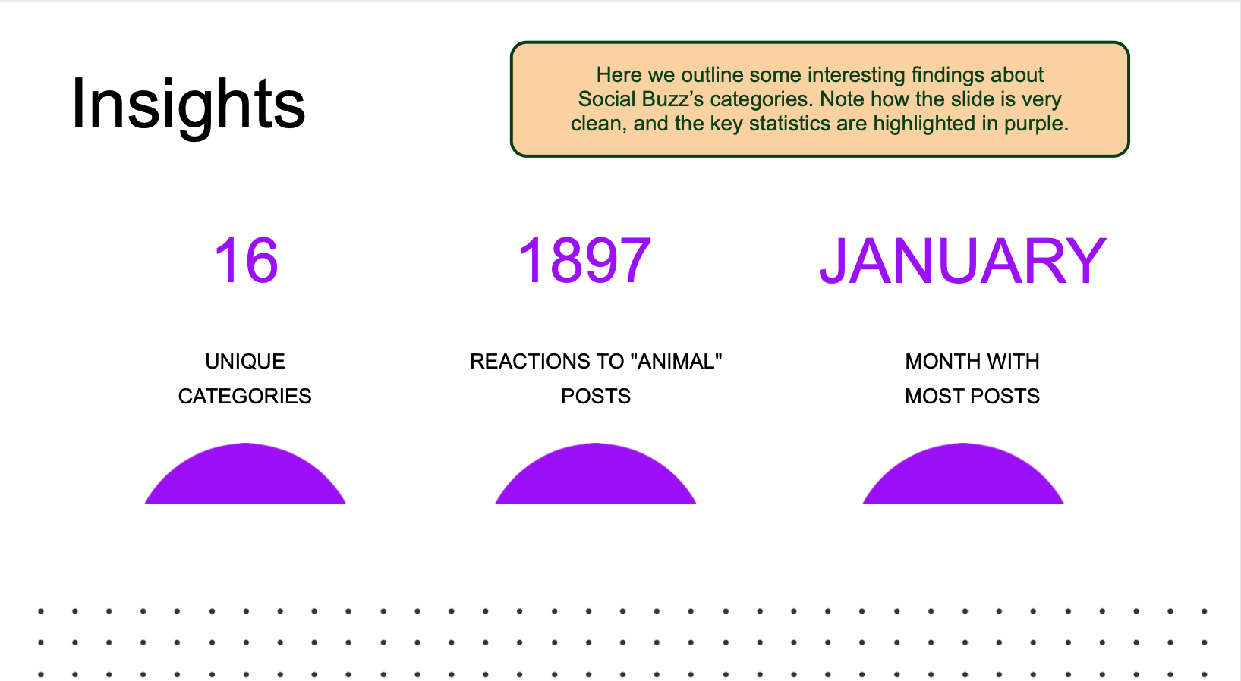

Insights

Slide 8
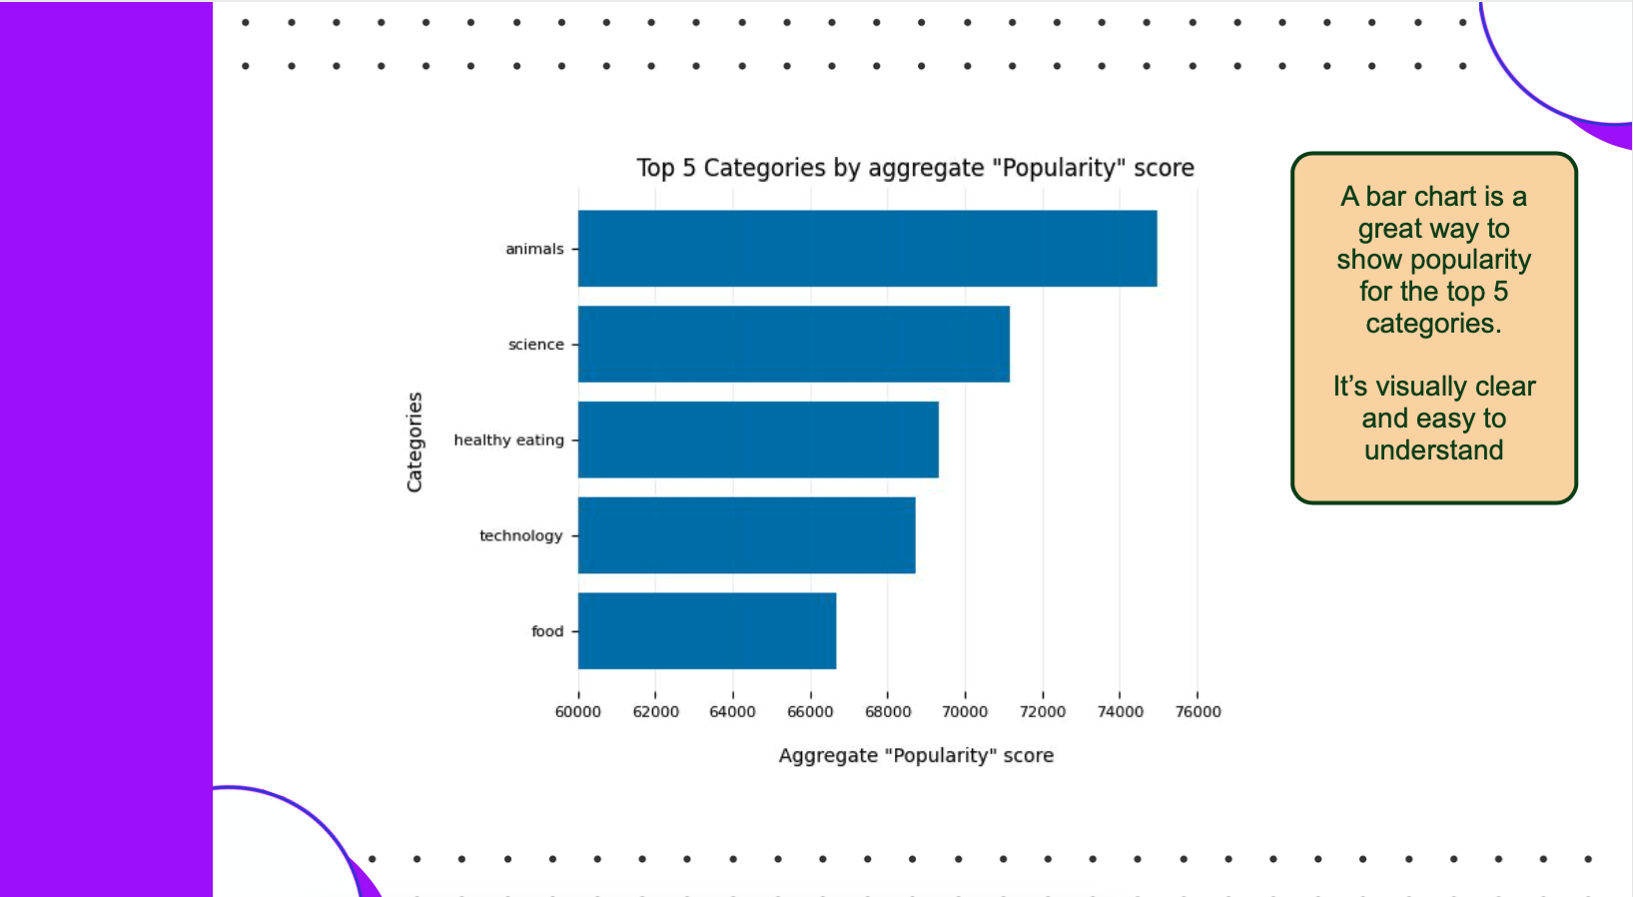

Slide 11


Slide 12

Top 5 Categories are : Animals, Science, Healthy Eating, Technology and Food.
There are 17 unique categories.
Also, there are total 74965 reactions to the most popular category.
Summary

Slide 13

Thank you!
ANY QUESTIONS?

